Slide 1
An introduction to the academic library
Yoel Kortick
Senior Librarian

Slide 2

Agenda
What is an academic library?
The function of the academic library
Services provided by the academic library
Professional departments in the academic library
Current challenges

Slide 3
What is an academic library?

Slide 4
What is an academic library?
A university’s executive management wants to see the link between institutional strategic goals and academic support services, including the library. Evidently the library’s strategic plan cannot achieve its goals if it does not respond to institutional goals. ¹
Chiware, Elisha. (2014). Aligned: an academic library’s strategic plan in response to institutional goals. Cape Peninsula University of Technology

Slide 5
What is an academic library?
The report emphasizes tying the function of the academic library to institutional mission and outcomes by identifying and understanding the parent institution’s mission and goals; identifying and understanding how the library contributes to these; and communicating that alignment.²
Cottrell, Janet R. What are we doing here, anyway?: Tying academic library goals to institutional mission. College & Research Libraries News. Association of College & Research Libraries. Vol 72, No 9 (2011).

Slide 6
What is an academic library?
A unit which serves to “strengthen the learning and research activities of students and staff of the University”. ¹
An Academic Library is defined as the library associated with a degree-granting institution of higher education. ²
Academic libraries are “libraries in higher education, from technical institutes to research universities”. ³
https://www.monash.edu/library/services
http://www.ala.org/tools/research/librarystats/academic
http://www.rpajournal.com/dev/wp-content/uploads/2012/05/A23.pdf

Slide 7
What is an academic library?
We can thus conclude that there are two main characteristics of the academic library:
It is associated with an institution of higher education, typically a college or university. It is also funded by the institution.
It aligns itself with goals of the institution (college, university, etc.) in order to assist in fulfilling those goals.

Slide 8
The function of the academic library

Slide 9
The function of the academic library
A review of the literature suggests that the most important service provided by the academic library is to offer training programs to improve users’ information literacy and assist them to find and use resources and other information. ¹
The library is tailored to accommodate the academic programs that [the institution] offers and to the research of its faculty members. ²
“Academic library services support for research information seeking”. Jia Tina Du and Nina Evans. Australian Academic & Research Libraries. Volume 42 Number 2.
https://www.idc.ac.il/en/library/pages/library-services.aspx

Slide 10
The function of the academic library
The Library needs to continue to contribute strategically and operationally to the full range of University strategic goals. ¹
Academic libraries provide resources and services to support the learning, teaching, and research needs of students, faculty, and staff. ²
Academic libraries ... support institutions of higher education ... They comprise an integral and important part of creating, preserving, and accessing the world’s knowledge. ³
https://docs.lib.purdue.edu/cgi/viewcontent.cgi?article=1941&context=iatul
http://www.ala.org/news/state-americas-libraries-report-2015/academic-libraries
https://www.degruyter.com/downloadpdf/books/9783598441349/9783598441349.505/9783598441349.505.pdf

Slide 11

The function of the academic library
All these points are directly related to what we already stated when we asked, “What is an academic library?”: The academic library aligns itself with goals of the institution in order to assist in fulfilling those goals.
Everything the academic library does is ultimately a means of fulfilling the goals of the institution.
And … this bring up another issue: How involved in the general community should the academic library be? Should all resources be geared only to the goals of the institution? What about the general public?

Slide 12
Services provided by the academic library

Slide 13
Services provided by the academic library
The services provided by the library to its users vary from institution to institution.
The services listed here are present in the vast majority of academic libraries
As we will see, the services are both
“traditional” in providing physical and electronic academic learning resources to the users
“non-traditional” in providing spaces to learn, laptops, phone chargers, coffee, and meeting rooms (more about this in a moment).

Slide 14
Services provided by the academic library
Fulfillment
  Circulation of physical items
  Access to electronic resources
  Interlibrary loans
Reference services
  Assistance in research
Course reserves

Slide 15
Services provided by the academic library
Library instruction and information literacy
Provide learning and meeting space
  “Book a room”
  Both as groups in reserved rooms and individuals
  Both formal and informal space
Provide Equipment
  Projectors
  Laptops and tablets
  Chargers and adapters
  Scanners and Printers

Slide 16
Services provided by the academic library
In recent years particular services in the academic library have grown.
These include
  The “learning and meeting space”
  The loaning of equipment such as laptops, tablets and chargers
  Space for drinking coffee and congregating in an informal atmosphere including group rooms for collaboration
Open spaces are often referred to as “learning commons” which may include
  Space for group meetings
  Exhibitions
  Art galleries
  Public lectures
  Library cafes

Slide 17

Services provided by the academic library
One reason for the change in services provided by the library is related to how users use the library.
https://i.pinimg.com/originals/a5/92/6f/a5926f66185821a7e7023db2da520273.png

Slide 18
Services provided by the academic library
In the (not so distant) past users would need to physically come to the library to use or loan materials.
Today very often the library “comes to the user” via electronic access to resources which can be accessed on a variety of devices from just about anywhere.
If the library will still bring users to the actual physical library, then there needs to be something to bring them there: meeting rooms, informal collaborative meeting space, coffee, equipment etc.

Slide 19
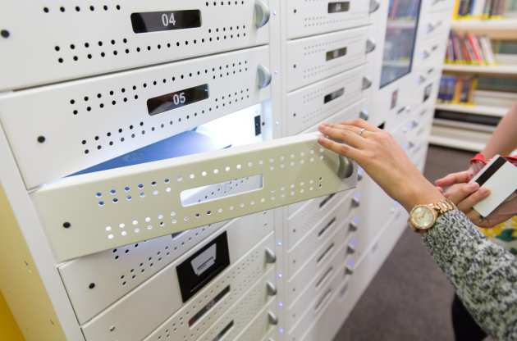
Services provided by the academic library
For example … The Imperial College of London Central Library has 36 laptops for Imperial students to borrow for up to 4 hours. ¹
https://www.imperial.ac.uk/admin-services/library/use-the-library/borrowing-a-laptop-or-ipad/

Slide 20
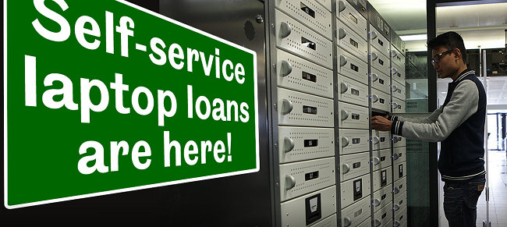
Services provided by the academic library
For example … The University of Sheffield library has 24 hour loan self service laptops . ¹
https://libraryhelp.shef.ac.uk/faq/102172

Slide 21
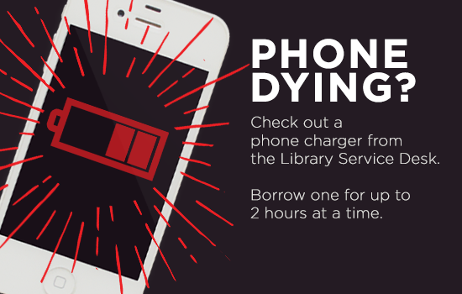
Services provided by the academic library
For example … The Library of the Concordia University of Edmonton has phone charges for loan . ¹
http://concordia-library.tumblr.com/post/134874111529/check-out-the-phone-charger-with-your-student

Slide 22
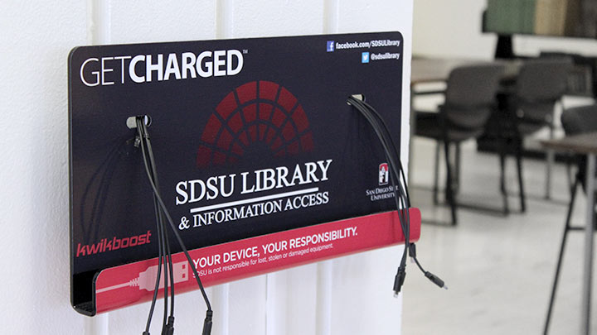
Services provided by the academic library
For example … San Diego State library provides multiple locations of phone charging stations. ¹
https://library.sdsu.edu/computers-technology/phone-charging-stations

Slide 23

Services provided by the academic library
For example … The University of Manchester Library operates a zoning policy which incorporates areas designated for the consumption of food and drink, as well as a cafe. ¹
http://www.library.manchester.ac.uk/locations-and-opening-hours/main-library/library-lounge/

Slide 24

Services provided by the academic library
For example … The University of the Pacific libraries provide free coffee during exam week.¹
https://twitter.com/PacificLibrary/status/940341411299205121

Slide 25
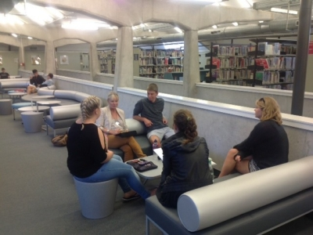
Services provided by the academic library
For example … The University of Auckland has created informal and interactive learning spaces in the library so students and staff can learn collaboratively “in ways that reflect 21 Century learning”.¹
http://www.education.auckland.ac.nz/en/about/news/news-2014/2014/03/20/New-interactive-informal-learning-spaces.html

Slide 26
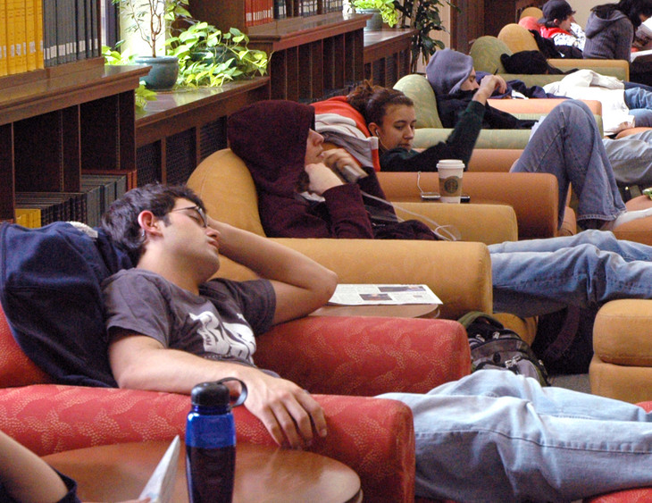
Services provided by the academic library
For example … The second-floor lounge of the Pattee Library of Penn State University includes space where users can study in an ‘informal’ atmosphere. ¹
https://news.psu.edu/photo/366245/2015/08/20/sleep

Slide 27
Professional departments in the academic library

Slide 28
Professional departments in the academic library
While every academic library does not have the same exact departments, the list in the following slide represents a typical set of departments present in most academic libraries

Slide 29
Professional departments in the academic library
Administration
Cataloging [part of “Technical Services”]
Collection Development/Acquisitions [part of “Technical Services”]
Circulation/Access Services
Digital Collections
Interlibrary Loan/Resource Sharing
Reference
Special Collections/Archives
Sound & Image
Systems
So You Want to Work in a Library... A guide to help you explore the profession of librarianship and other library jobs. Florida International University. https://library.fiu.edu/sywtwinalibrary/libdepts

Slide 30
Professional departments in the academic library
While the previous slide listed specific departments, there is also a larger department known as “Technical services”.
Library technical services includes cataloging and collection development / acquisitions.

Slide 31
Professional departments in the academic library
Administration
Library administration deals with day-to-day administrative operations including
  Documentation of library staff employment
  Payment of invoices for services rendered to the library
  Creation and maintenance of library budget reports
  Ordering of supplies for the library and staff
  Maintenance of the library's facilities.

Slide 32
Professional departments in the academic library
Cataloging
Cataloging departments create and maintain the online catalog of the library
This includes
  Describing, classifying and indexing library materials
  Periodic quality control on existing records
  General database management to ensure that the resources are accessible to the users

Slide 33
Professional departments in the academic library
Circulation
Circulation departments
  Ensure physical and electronic access to library materials
  Maintain the library collections so they can be properly accessed
  Assist library users
  Organize the course of reserve materials so that it can be accessed and when possible loaned.

Slide 34
Professional departments in the academic library
Collection development / Acquisitions
Collection development / Acquisitions departments manage the purchase and processing of library resources.
This includes
  Purchasing items
  Coordinating licensing and access of electronic resources
  Periodically assessing the collection to know what is and is not being used as a guide to what should be purchased

Slide 35
Professional departments in the academic library
Digital collections
Digital collections departments manage library resources, collections, and repositories.
Part of this “managing” involves ensuring online access to digital collections.
Digital collections departments digitize and preserve information resources of cultural and historical interest.

Slide 36
Professional departments in the academic library
Interlibrary loan
Interlibrary loan (also known as resource sharing) departments work together with other libraries to borrow and share resources.
This involves processes includes acquiring, receiving, paying for, and then ultimately providing the material to the end user.

Slide 37
Professional departments in the academic library
Reference
Reference departments provide instructional services to all library users
This may be
  In person
  Online reference help
  Bibliographic instruction classes
  Tutorials
  Research guides
  Subject specialist support

Slide 38
Professional departments in the academic library
Special Collections
Special collections departments deal with unique primary source materials such as rare books, manuscripts, archives, artifacts, and media.
This involves
  Acquiring
  Preserving
  Providing access

Slide 39
Professional departments in the academic library
Sound & Image
  Sound & Image departments maintain and provide access to audiovisual resources
  These may be:
    DVDs
    Streaming video
    LPs and CDs
    Slides
This may also involve providing technology needed to access these resources such as VCRs and record players.

Slide 40
Professional departments in the academic library
Systems
Systems departments provide technology service to library users as well as other departments in the institution.
This typically will involve maintaining a website and integrating with external systems in the institution.

Slide 41
Current challenges

Slide 42
Current challenges
Budget
  The library needs to prove it’s value in the institution in order to continue receiving funding
Technology
  The library needs to integrate with and share data with other organizations both inside and outside the institutions. This often involves various protocols and data processing using the latest technology

Slide 43
Current challenges
Understand research trends
  With the wealth of information available, and end users used to “Google searching”, the library needs to provide an added-value in the research process
Stay current on various policies and standards
  International standards are constantly changing and directly affect the library. This includes for example MARC standards and personal data regulations

Slide 44
Current challenges
Tracking library performance
  If the goal of the library is to advance the goals of the institution, then how can this be measured and tracked?
Transforming space
  The real estate of the library is very valuable. With the increase of electronic resources and weeding of physical resources more space may become available. If now the library (electronic resources) goes to the user instead of the user going to the library, then how can this space be used to bring the user back to the library

